Slide 1

Epidemiology of
Vector-borne Diseases
Maureen Brophy, MPH
Ph.D. Student

Slide 2
Vector-borne Disease Epidemiology
Understanding risk of vector-borne disease
Disease transmission
Mosquito diseases and control
Tick diseases and control

Slide 3
Vector-borne Disease Epidemiology
Understanding risk of vector-borne disease
Disease transmission
Mosquito diseases and control
Tick diseases and control
Epidemiology: The study of the distribution and determinants of disease
Who gets sick, why, where, when, how

Slide 4
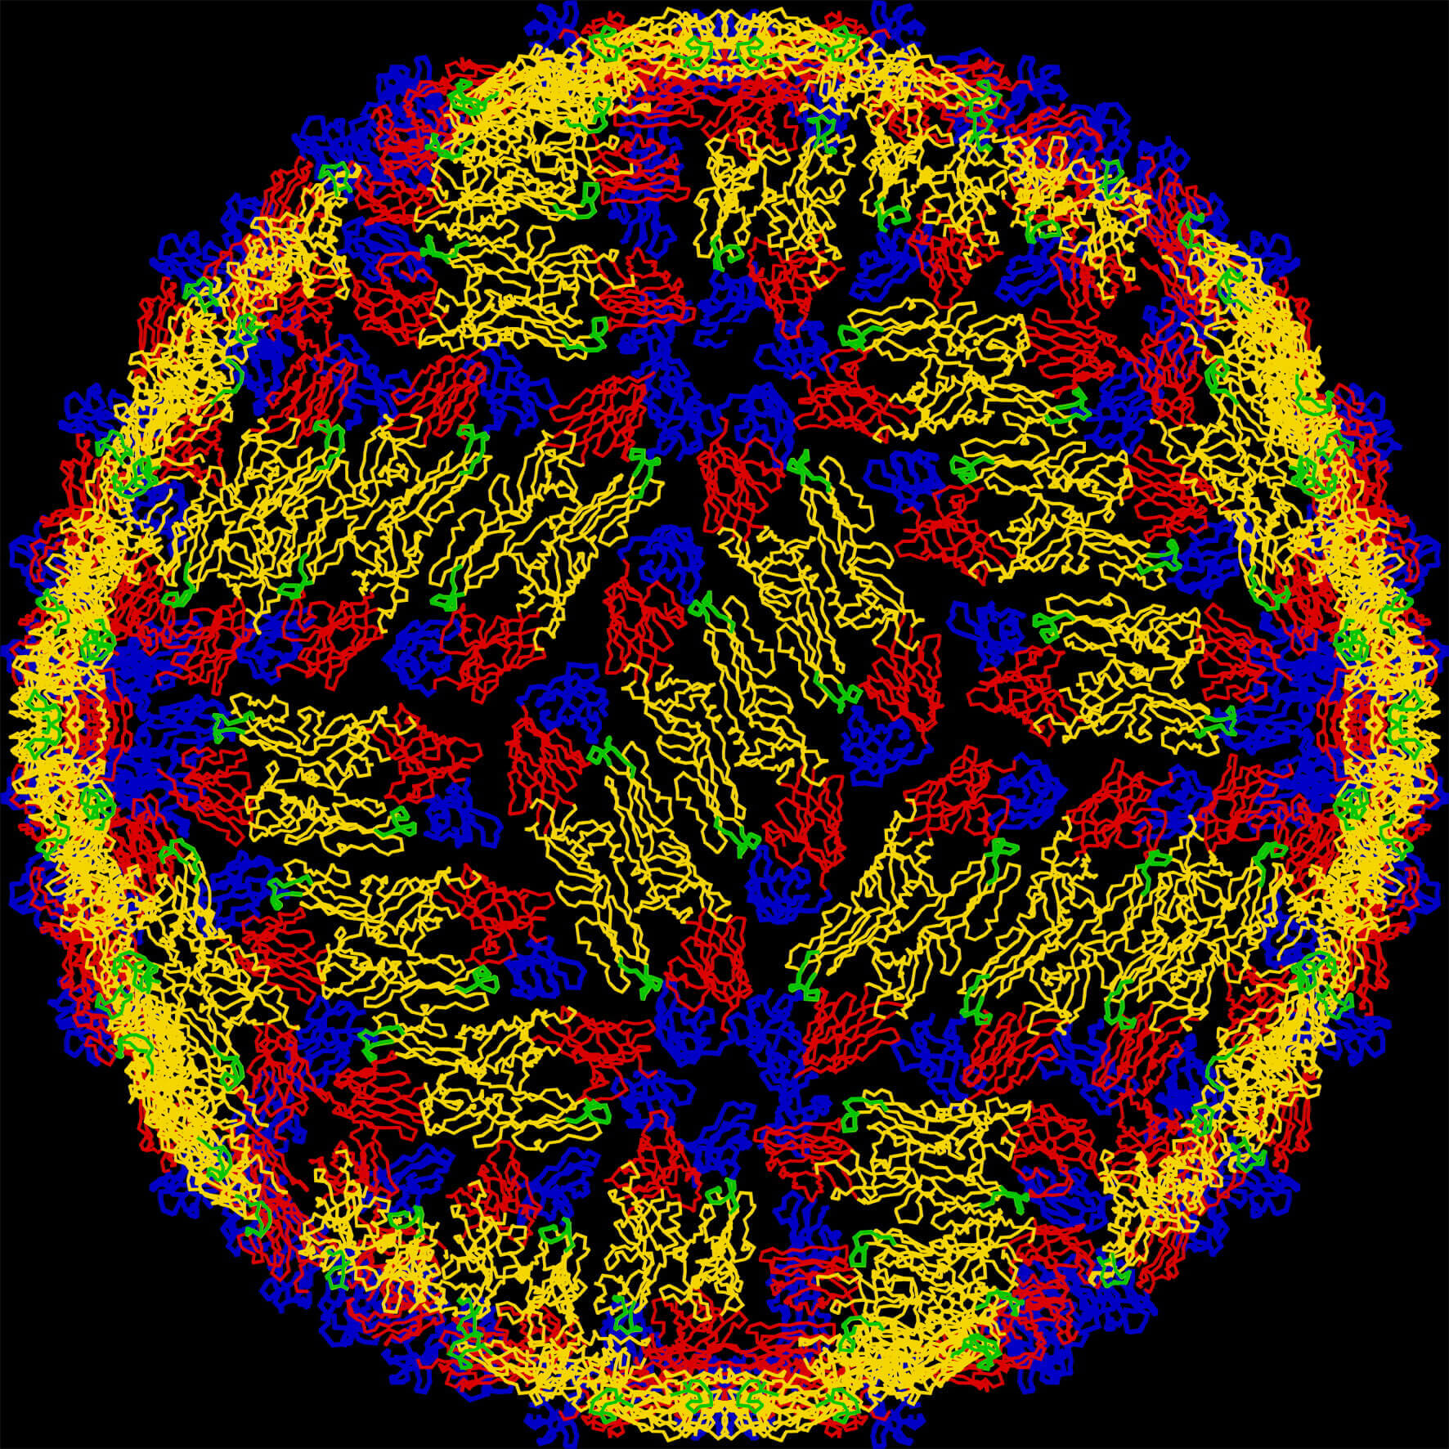
Understanding Risk of Vector-borne Disease
Vector competence
Vector capacity
Purdue Univ.

Slide 5
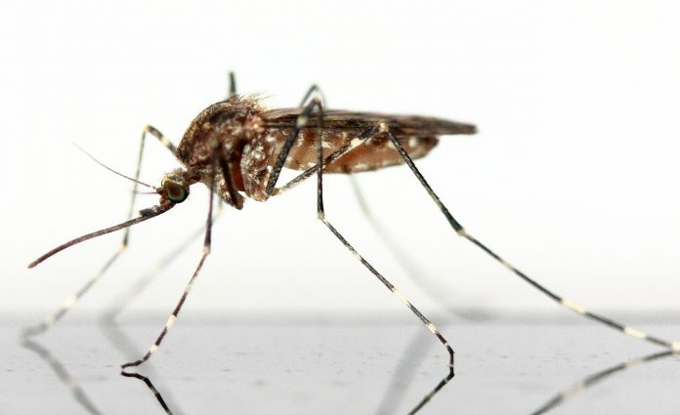
Vector Competence
How likely is the disease to survive inside the vector and be able to get passed to the host?
CDC
Notes:
What hoops will the pathogen have to go through within the tick in order to be transmitted to their next host? BC BDT feeds on an animal close to humans, we get put at risk.

Slide 6
Vector Competence
Host preference
Longevity- how long the vector lives
Household structures, ability for mosquito to reach host
Environmental conditions
Internal factors (pH, innate immunity, presence of other bacteria)
Notes:
What hoops will the pathogen have to go through within the tick in order to be transmitted to their next host? BC BDT feeds on an animal close to humans, we get put at risk.

Slide 7
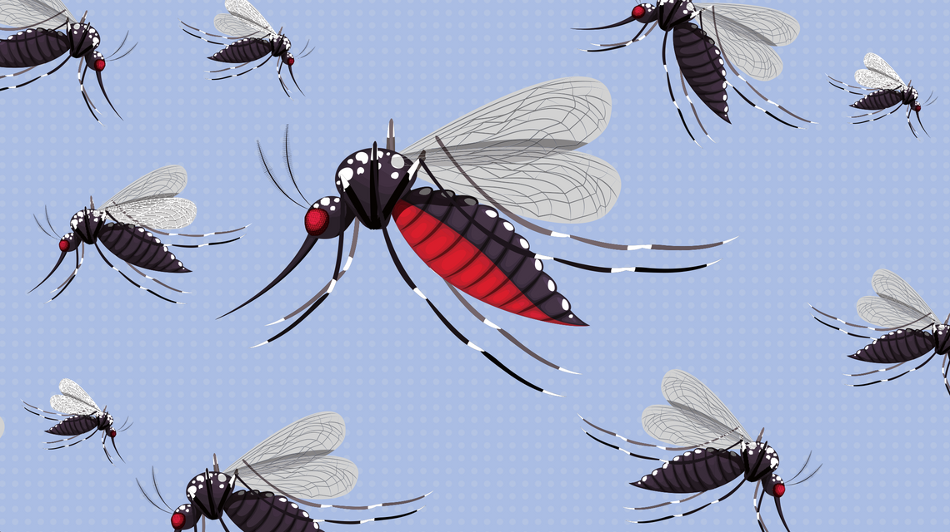
Vector Capacity
How likely is the vector population to be able to cause more infections after getting infected
Australia Science Channel

Slide 8
Vector Capacity
Number of vectors per person
How often/when they bite humans
Vector competence
Mosquito survival
How long it takes for the mosquito to become infective
How long the mosquito lives after becoming infective

Slide 9
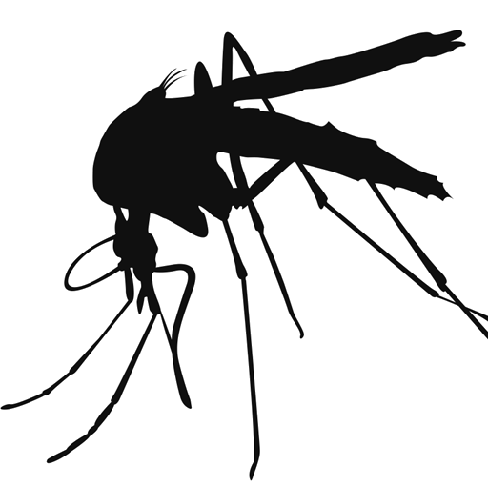
How Does a Mosquito Get Infected?
Many hurdles to jump for a pathogen to get to next host
Physical barrier in gut formed during feeding to protect mosquito from pathogens
Mosquito immunity- different from humans, but can fight off pathogens
Only portion of pathogen population makes it to mosquito
Must develop and/or reproduce in mosquito

Slide 10
Mosquito Diseases
Most mosquitoes cannot transmit diseases
Mosquitoes that can transmit certain diseases cannot do so everywhere they are found- depends on environment

Slide 11
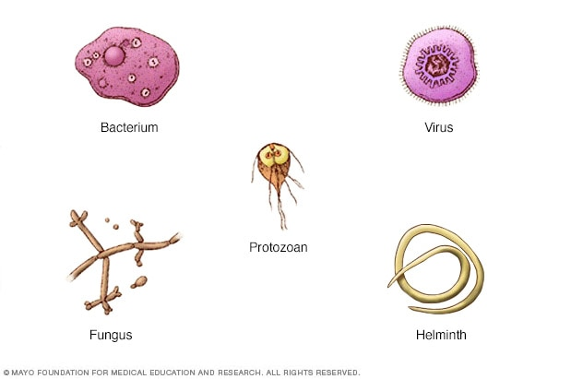
Mosquito Diseases
Mosquitoes can transmit different types of pathogens
Viruses
Bacteria
Parasites

Slide 12
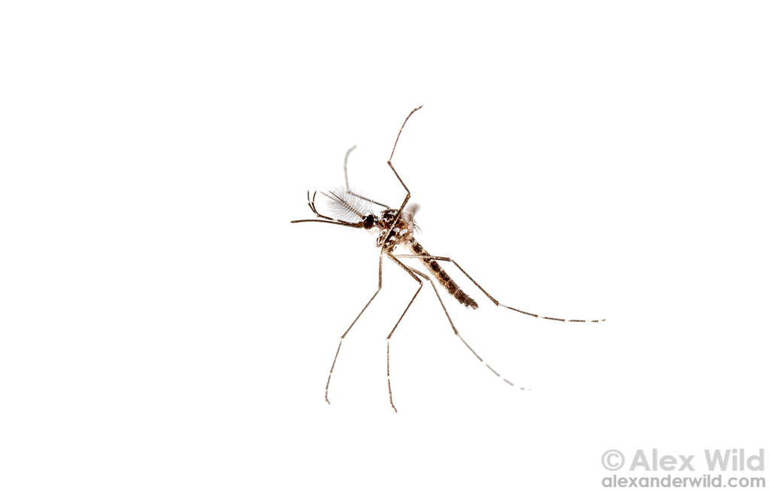
Dog Heartworm
LaCrosse Encephalitis
West Nile Virus
Zika Virus
Yellow Fever
Dengue
Chikungunya
Eastern Equine Encephalitis
St. Louis Encephalitis
Malaria
Western Equine Encephalitis

Slide 13
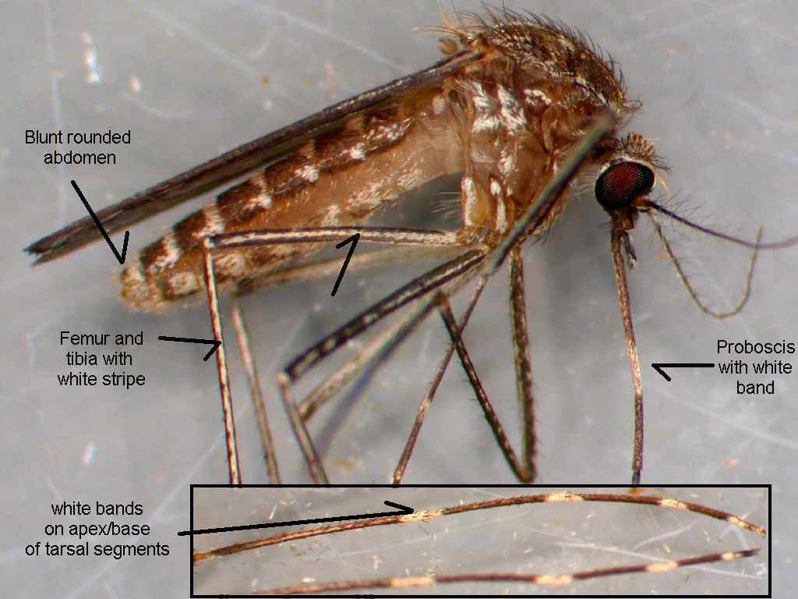
Culex Species
Notes:
AZ is home to over 40 species of mosquitoes- most of which, while annoying, don’t spread disease

Slide 14
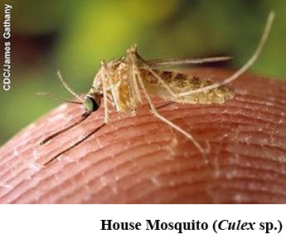
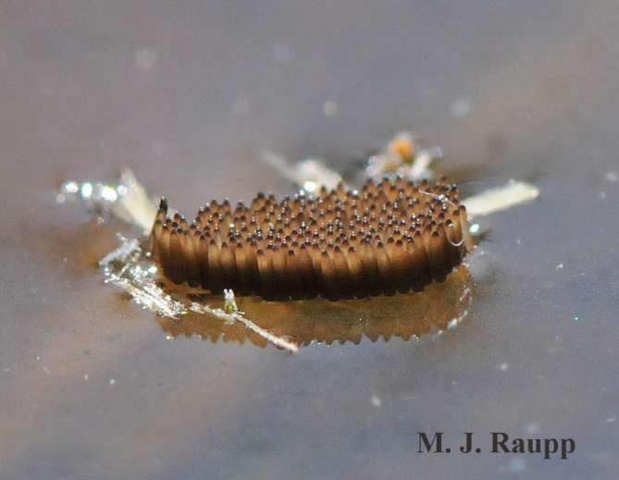
Culex Species
Transmits WNV and SLEV
Prefer to feed on birds
Live in or sewage systems, irrigated fields, man made containers
Dawn and dusk biters
Lay “raft” of eggs in still water
Can survive colder temperatures by hiding out indoors and other protected areas

Slide 15
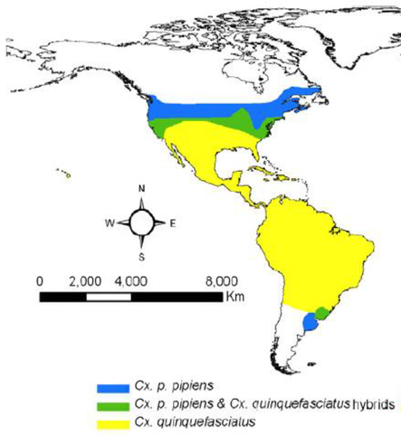
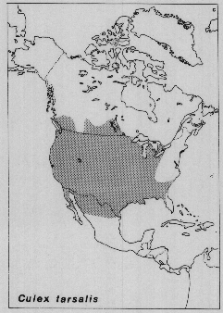
Culex in US

Slide 16
Dog Heartworm
West Nile Virus
St. Louis Encephalitis

Slide 17
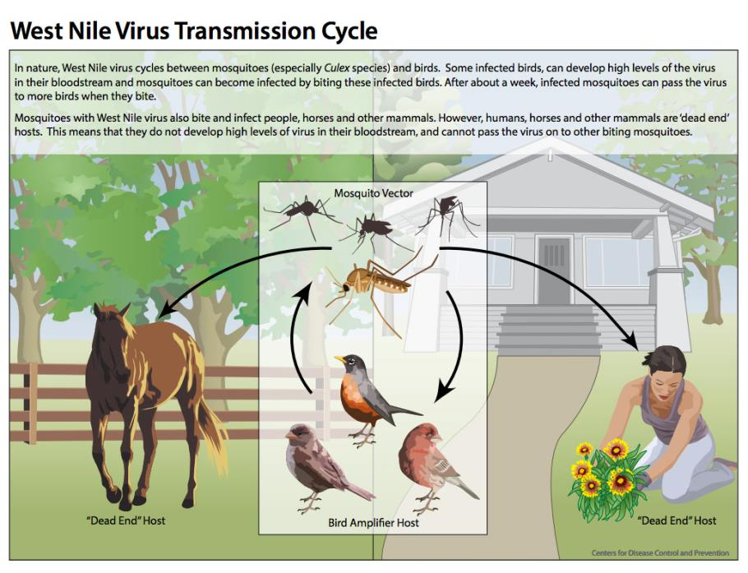

Slide 18
West Nile Virus
About 1 in 5 people who are infected will develop a fever and headache, body aches, joint pains, vomiting, diarrhea, or rash
Less than 1% of people who are infected will develop encephalitis or meningitis (inflammation of the brain or surrounding tissues)

Slide 19
West Nile Virus
People over 60 years of age are at the greatest risk for severe disease
  People with cancer, diabetes, hypertension, kidney disease, are also at greater risk for serious illness.
Recovery from severe disease may take several weeks or months.
No vaccine or specific treatments for WNV infection are available

Slide 20
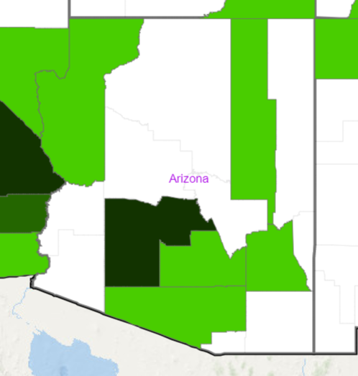
West Nile Virus Human Cases, 2018
Arbonet, CDC

Slide 21
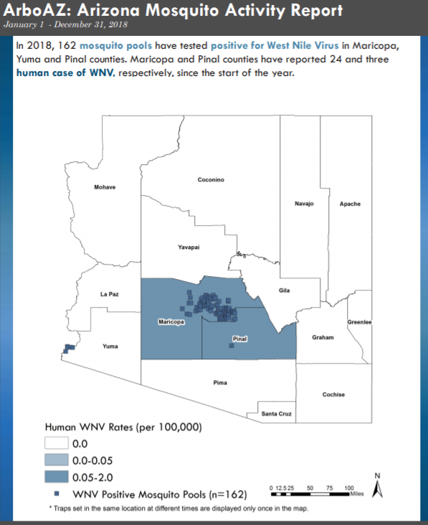

Slide 22
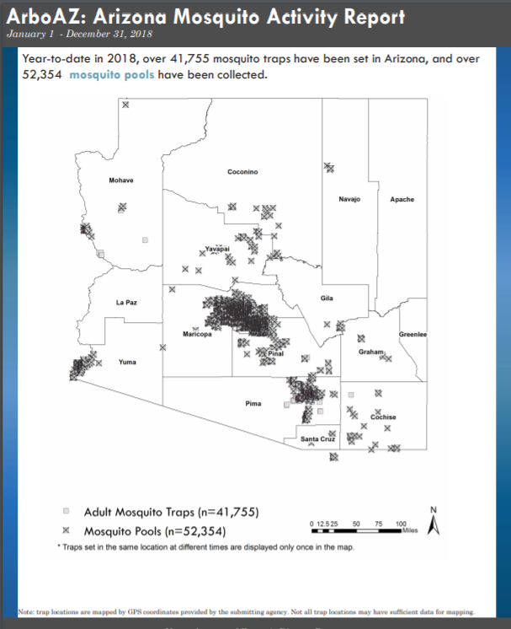

Slide 23
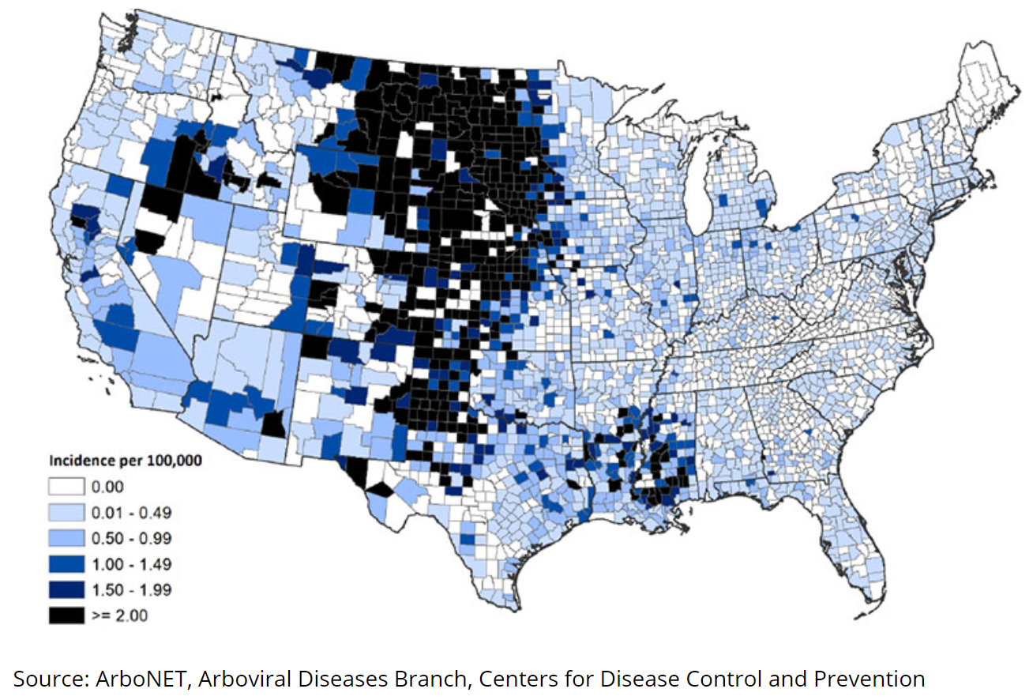
Average annual incidence of West Nile virus neuroinvasive disease reported to CDC by county, 1999-2017

Slide 24
St. Louis Encephalitis Virus
Less than 1% of people have symptoms, but can cause severe illness in the elderly
Symptoms are fever, headache, dizziness, nausea, and discomfort (flu-like)
Severe disease: Stiff neck, confusion, disorientation, dizziness, tremors and unsteadiness

Slide 25
St. Louis Encephalitis Virus
More mild in children than in older adults.
About 40% of children and young adults with SLEV disease develop only fever and headache or aseptic meningitis
Almost 90% of elderly persons with SLEV disease develop encephalitis
No vaccine or specific treatments for SLEV infection are available

Slide 26
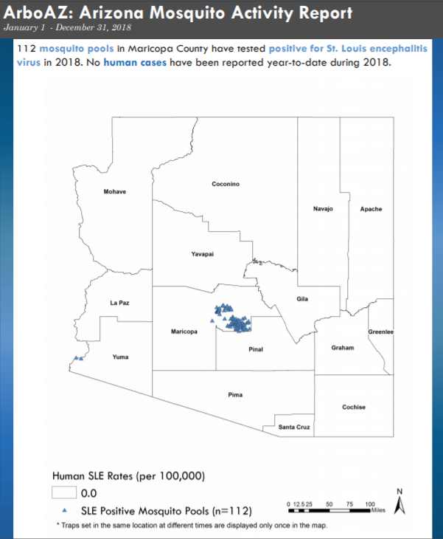

Slide 28
Zika Virus
Yellow Fever
Dengue
Chikungunya

Slide 29
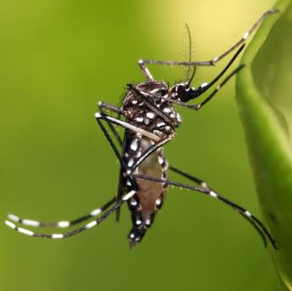
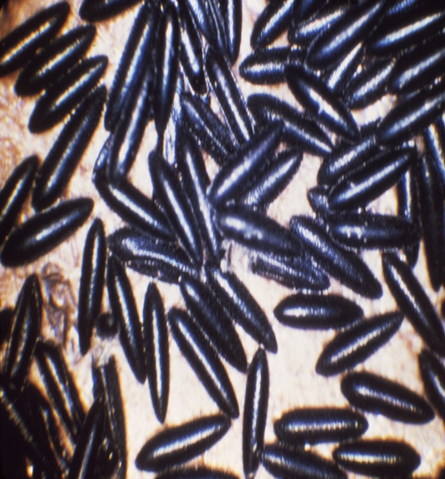
Aedes Mosquitoes
Includes many nuisance and some disease-spreading species
In AZ, are A. aegypti and A. albopictus are vectors
Can transmit Zika, dengue, and chikungunya viruses
Prefer to feed on humans
Daytime biters
Live in or near households

Slide 30
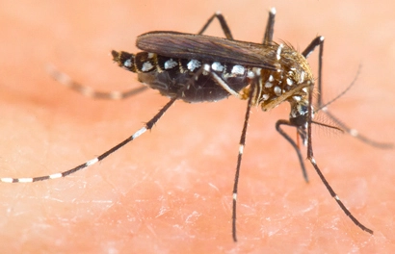
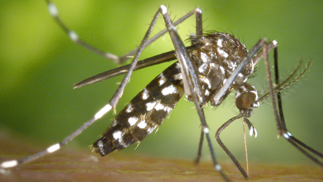
Aedes Mosquitoes
A. albopictus
  Lays its eggs on flooded soil
  Very aggressive
A. aegypti
  Lays its eggs in containers (as small as a bottle cap)
  Not very aggressive
Notes:
These two look very similar- the key difference is on their “backs” (scutum)- aegypti have lyre/harp-shaped white markings, and albopictus have a white stripe
Both daytime biters, both have short flight ranges

Slide 31
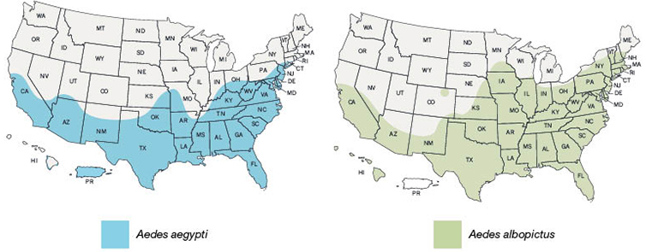
Aedes Species in US
These maps represent CDC's best estimate of the potential range of Aedes aegypti and Aedes albopictus in the United States

Slide 32

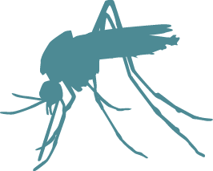
Zika Virus
Spread through
  Mosquito bites
  From a pregnant woman to her fetus
  Sex with an infected person

Slide 33
Zika Virus
Many people with Zika will not have symptoms or will only have mild symptoms.
Symptoms last several days to a week.
People usually don’t get sick enough to go to the hospital.
People very rarely die of Zika.

Slide 34
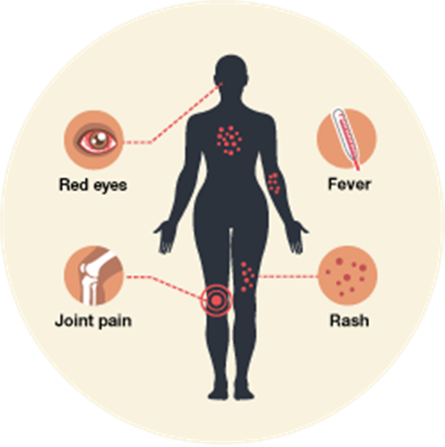
Zika Symptoms
Low-grade fever
Joint pain/swelling
Muscle pain
Rash
Headache with pain behind eyes
Red eyes

Slide 35
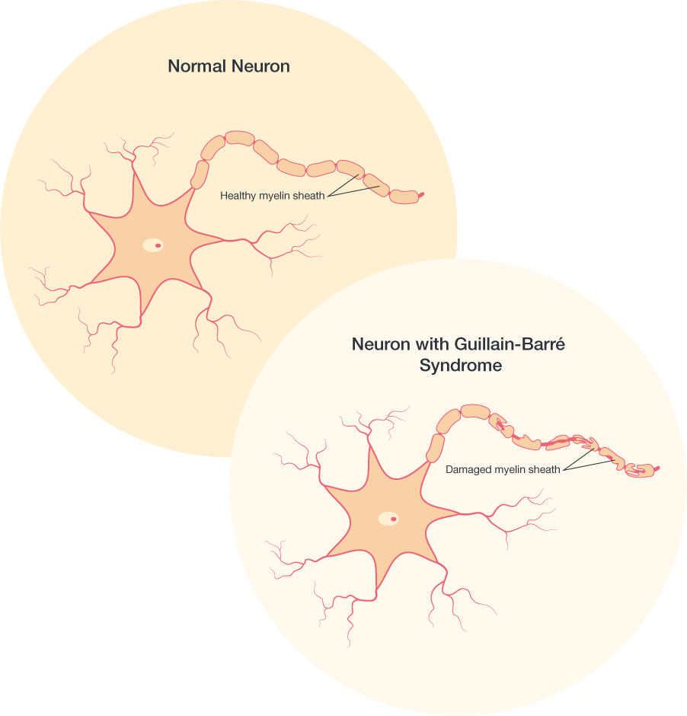
Zika Symptoms
Linked to Guillain-Barré syndrome (GBS), which causes muscle weakness, and sometimes, paralysis
No specific treatment or vaccine

Slide 36
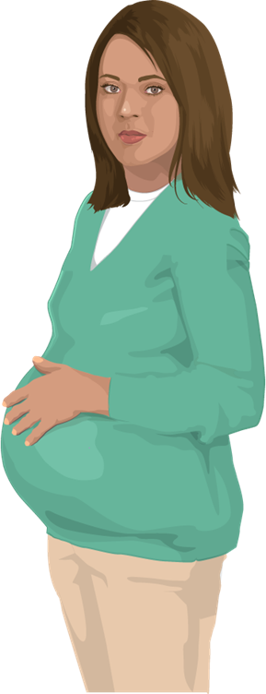
Zika and Pregnancy
Can cause microcephaly (small head size) and other severe brain defects if mother infected just before or during pregnancy
Linked to other problems, such as miscarriage, stillbirth, and birth defects
No evidence that past infection will affect future pregnancies once the virus has cleared the body

Slide 37
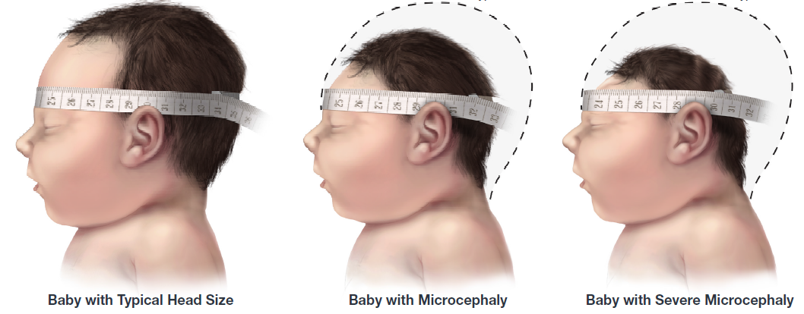
Congenital Zika syndrome
Severe microcephaly (small head size) resulting in a partially collapsed skull
Decreased brain tissue with brain damage
Damage to the back of the eye with a specific pattern of scarring and increased pigment
Limited range of joint motion, such as clubfoot
Too much muscle tone restricting body movement soon after birth
Notes:
All infants born to mothers with laboratory evidence of Zika virus infection during pregnancy should receive a comprehensive physical exam, head ultrasound to assess the brain’s structure, standard newborn hearing assessment, and lab testing for Zika virus, even if no abnormalities are apparent at birth.
Microcephaly has been identified as one feature of a unique pattern of birth defects, called congenital Zika syndrome, among fetuses and infants of women infected with Zika during pregnancy. https://www.cdc.gov/mmwr/volumes/65/wr/mm6533e2.htm?s_cid=mm6533e2_w
Recognizing that Zika is a cause of certain birth defects does not mean that every pregnant woman infected with Zika will have a baby with a birth defect. It means that infection with Zika during pregnancy increases the chances for these problems.
Although Zika virus is a cause of microcephaly and other severe brain defects and has been linked with these other problems in infants, there is more to learn. Researchers are collecting data to better understand the extent Zika virus impact on mothers and their children.

Slide 38
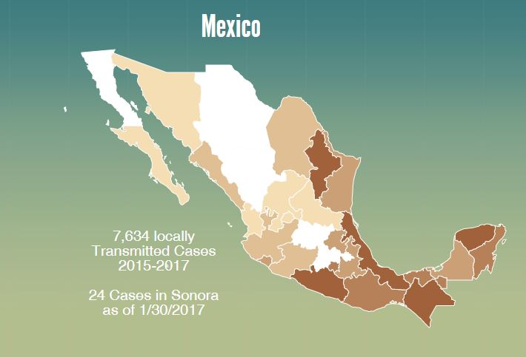
Zika in Mexico: 2017

Slide 39
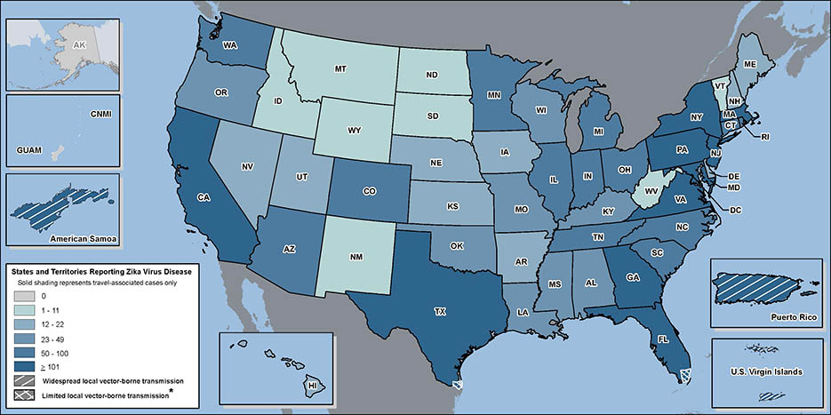
Zika in the U.S.: 2017

Slide 40
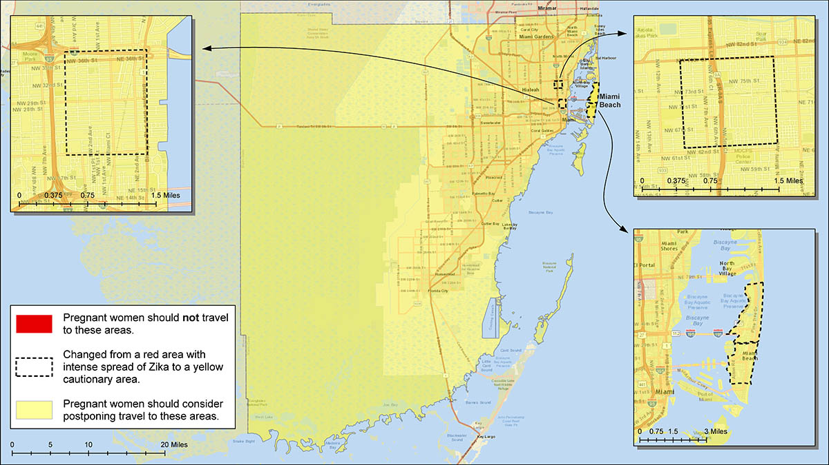
Florida Outbreak
Notes:
During August-December 2016 there was an ongoing outbreak of Zika in a 4.5 mile section of Miami Beach
214 cases of locally-acquired Zika were reported

Slide 41
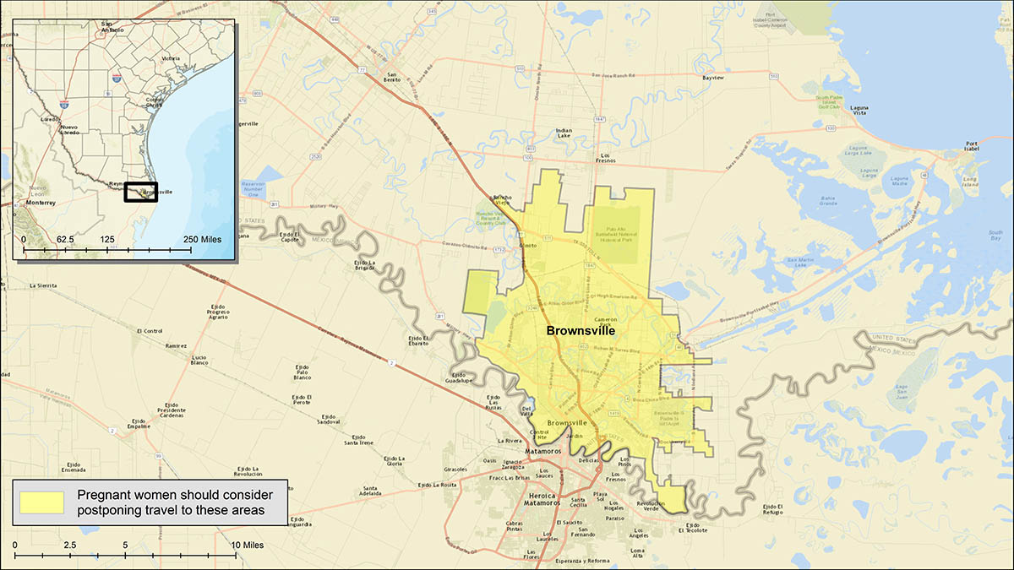
Texas Outbreak
Notes:
Texas reported its first case of locally acquired Zika at the end of November in Brownsville, in southern TX
There have been 6 cases reported in TX so far

Slide 42
Chikungunya Symptoms
Not in Arizona yet, but we have the right mosquitoes
Transmission by mosquitos only
Humans can infect mosquitoes during 1st week of illness
70–90% of exposed persons develop illness
38–63% of population affected in outbreak areas

Slide 43
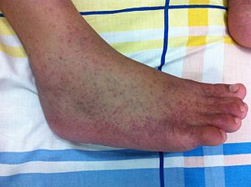
Chikungunya Symptoms
Most common: fever and joint pain
Other: headache, muscle pain, joint swelling, or rash
Rarely fatal, but can be severe/ debilitating
Symptoms usually last approx. 1 week
Joint pain can last long after infection is over

Slide 44
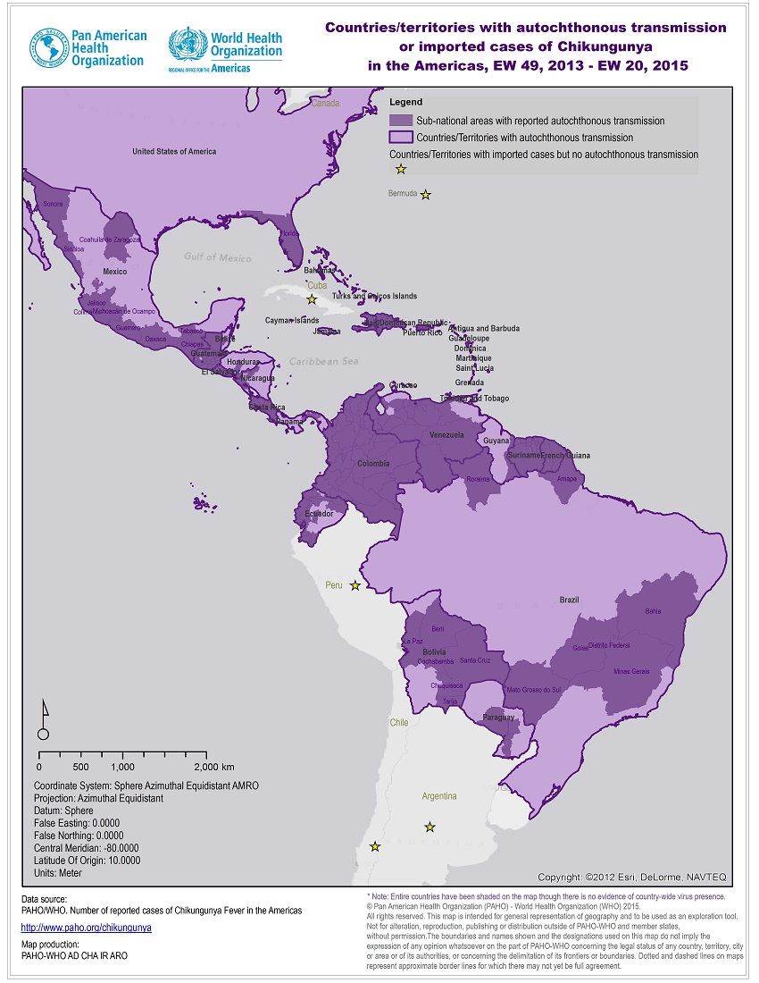
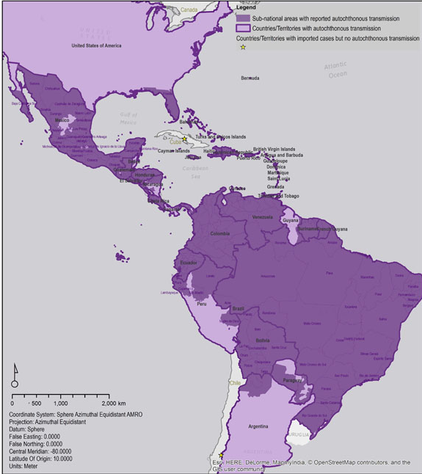
Chikungunya: May 2015-Feb 2017
May 19, 2015
February 18, 2017

Slide 45
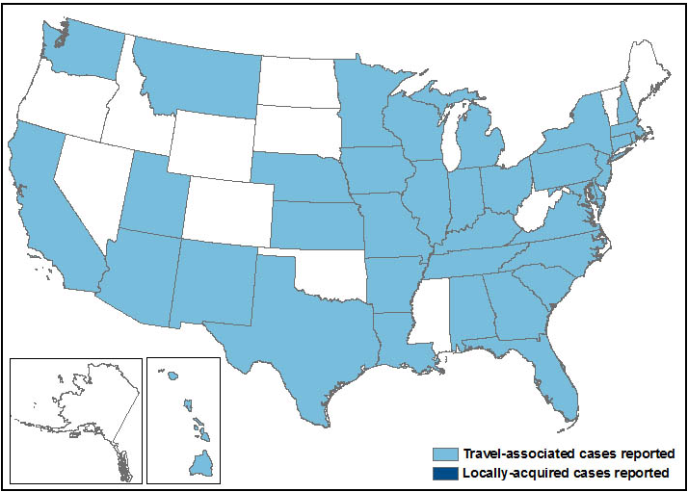
Chikungunya in the U.S.
679 cases reported in US
175 imported cases in US in 2016 (4 in AZ)
Mexico reported 757 cases in 2016, down from 11,577 in 2015
Detected in all Mexican states, including Sonora and Baja

Slide 46
Dengue Virus
Not in Arizona yet, but we have the mosquitoes
Transmission by mosquitos only
About 400 million people worldwide infected every year
Notes:
Transmitted by A. aegypti mostly, but the 2001 Hawaii outbreak was caused by A. albopictus

Slide 47
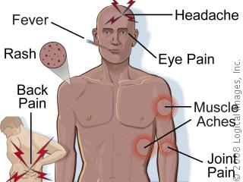
Dengue Symptoms
Dengue
  Fever, body aches, rash, nausea, vomiting, diarrhea
Severe dengue
  Dengue symptoms, plus symptoms of shock or hemorrhage following severe plasma leakage

Slide 48
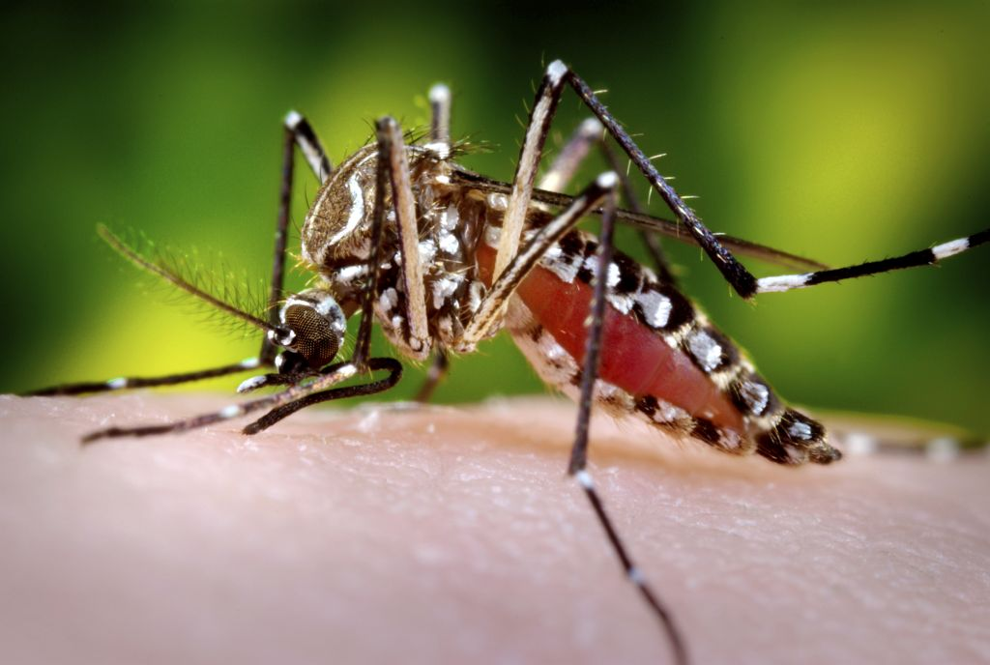
Dengue Fever
4 distinct serotypes
Up to 75% of cases may be asymptomatic
5% will develop severe, life-threatening disease
Protective immunity against the same serological strain
Infection with a different serotype has increased risk of hemorrhagic manifestations
Notes:
There are 4 distinct serotypes of dengue virus. Up to 75% of cases may be asymptomatic, but up to 5% will develop a sever, life-threatening disease. Individuals will develop immunity against the serological strain of dengue virus with which they are infected. However, if that individual becomes infected with a different strain, there is increased risk of these severe outcomes, including hemorrhagic manifestations of disease.

Slide 49
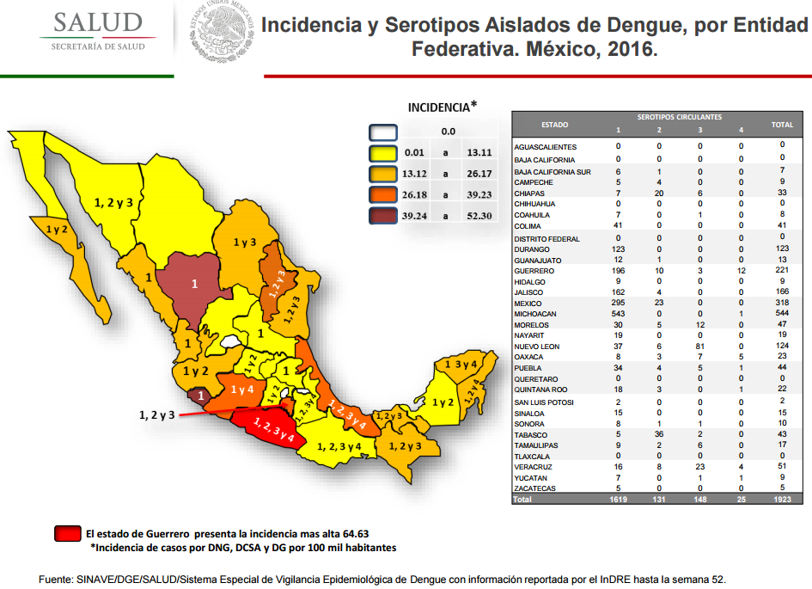

Slide 50
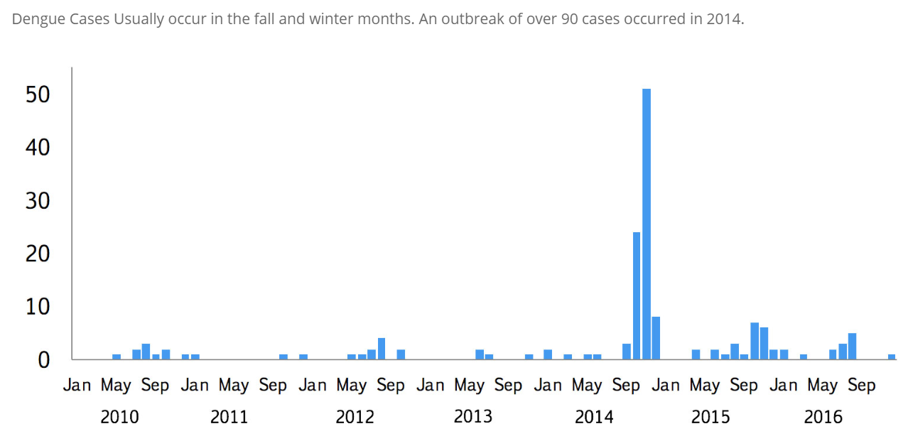
Arizona Dengue Cases

Slide 51
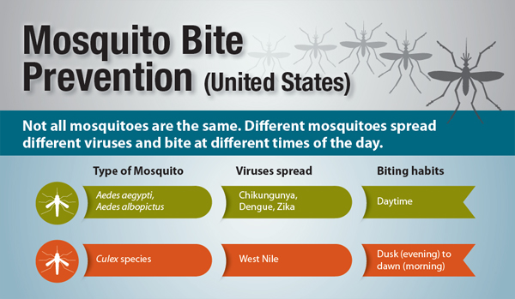
Difference Between Mosquitoes

Slide 52
Nuisance Mosquitoes
While unable to transmit disease, nuisance mosquitoes still bite humans and can cause itchy welts
Arizona has more nuisance mosquitoes than vector mosquitoes

Slide 53
Mosquito Control
Identify and remove breeding sites
Long sleeves & pants
Wear topical insect repellant
  DEET, Picardin, Lemon oil of eucalyptus
Use screens in open windows & doors
Citronella does not work!

Slide 54
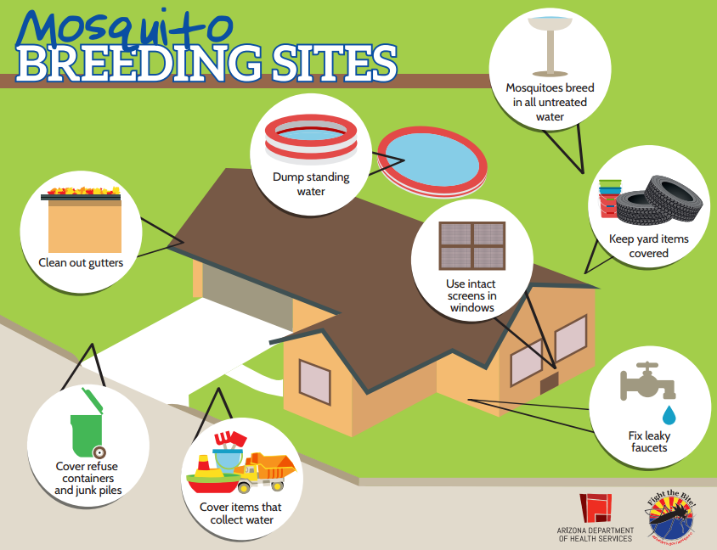
Notes:
Aedes aegypti have short flight distances. They like to stay close to their birthplace.
These mosquitos lay their eggs in standing water, both inside and outside of the home, so removing sources of water in and around your home will reduce mosquito breeding and help control the mosquito population. One of the best methods for source reduction is for residents to ensure there are no containers near the home that are uncovered and filled with water, or have the potential to hold water. Once a week, empty and scrub, turn over, cover, or throw out items that hold water, such as tires, buckets, planters, toys, pools, birdbaths, flowerpots, or trash containers. Check inside and outside your home. If you have any standing water that can’t be dumped, such as pools, ponds, etc., be sure to treat those with the appropriate chemicals. This will stop mosquitoes from laying eggs on your property.

Slide 55
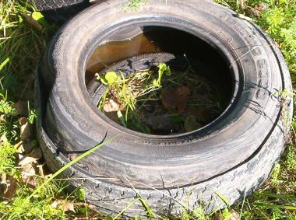
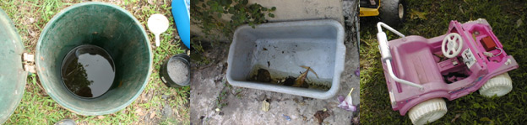
Prevention Begins at Home
Cover, turn over, throw away, or regularly clean water-holding containers

Slide 56
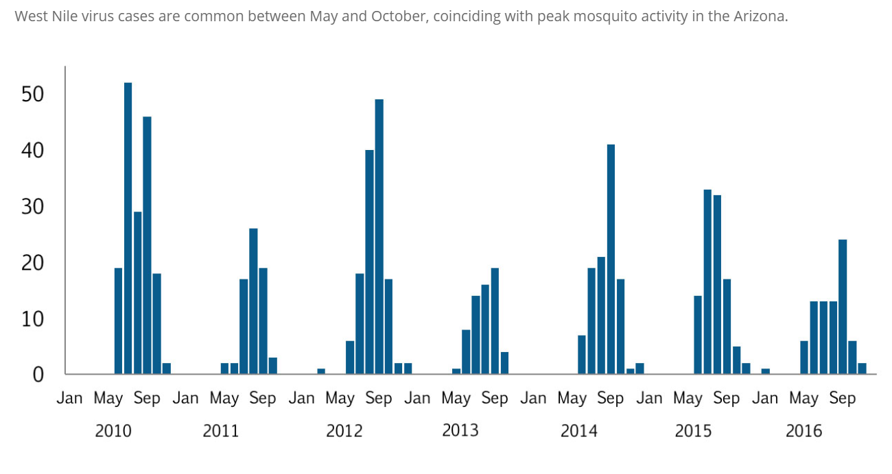

Slide 57
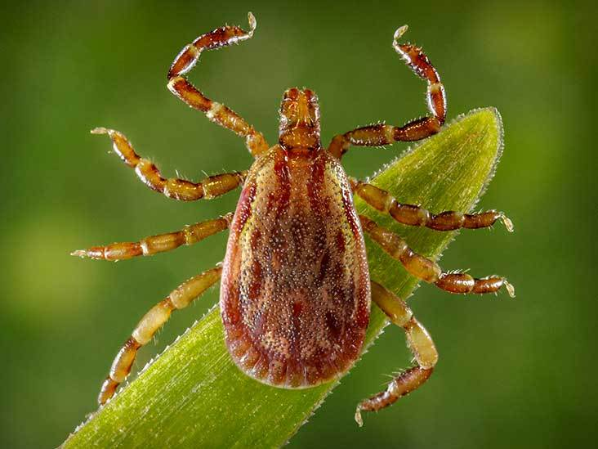
Ticks

Slide 58
Tick Diseases
Most vector-borne disease in the United States are transmitted by ticks
Ticks can also transmit a variety of different types of pathogens
Viruses
Bacteria
Parasites

Slide 59
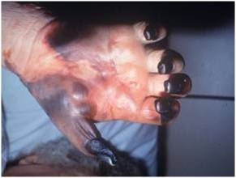
Rocky Mountain Spotted Fever (RMSF)
Fever
Headache
Rash
Cough/pneumonia
Severe stomach pain
Confusion
Multisystem organ failure
Death (1 out of 5 untreated patients)
Treatment: Doxycycline ASAP
Necrosis due to capillary damage from RMSF. Photo courtesy of CDC

Slide 60
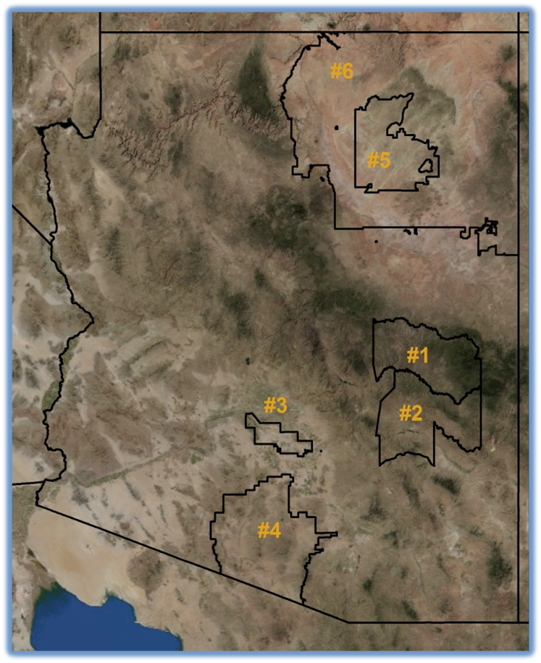
RMSF in Arizona
375 cases, 21 deaths in AZ since 2003
Case fatality 7%, ~15 X higher than the U.S. rate
Large outbreak going on in Sonora, Mexico (1,394 cases, 247 deaths since 2004)
Map of tribal lands in Arizona with evidence of RMSF numbered in order of detection. Courtesy of CDC.

Slide 61
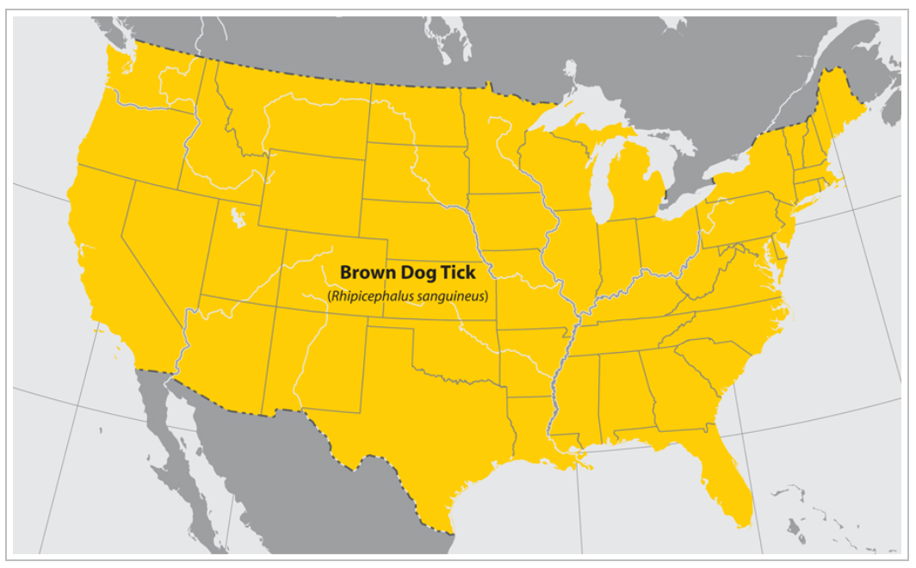

Slide 62
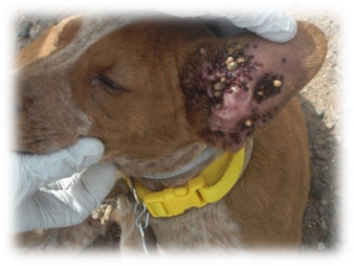
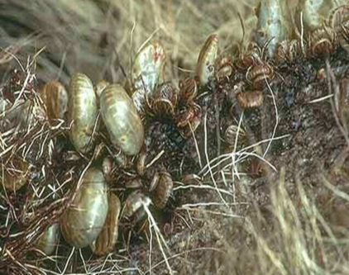


Your Dog and RMSF
You can't get RMSF from your dog - only from TICKS
  RMSF can make dogs sick as well
RMSF ticks like to feed on dogs
Free-roaming dogs can spread ticks into nearby homes and yards
  New puppies attract more ticks

Slide 63

Ornithodoros Species
Ornithodoros hermsi
  Found in coniferous forests at altitudes of 1,500 to 8,000 feet where it feeds on tree squirrels and chipmunks.
O. parkeri and O. turicata
  Generally found at lower altitudes in the Southwest
  Inhabit caves and the burrows of ground squirrels, prairie dogs, and burrowing owls
Soft ticks bite only briefly, usually less than ½ hour contact with host

Slide 64


Slide 65

Tick-borne Relapsing Fever
Borrelia bacteria transmitted through the bite of infected “soft ticks” of the genus Ornithodoros
Symptoms:
  High fever (103° F)
  Headache
  Muscle
  Joint aches
Symptoms can reoccur, producing a telltale pattern of fever lasting roughly 3 days, followed by 7 days without fever, followed by another 3 days of fever
Treated with antibiotics

Slide 66


Slide 67
Tick Paralysis
Not caused by a pathogen
Acute, ascending flaccid paralysis 4-7 days after tick attaches
Can be fatal
Symptoms resolve soon after tick is removed

Slide 68



Prevention
SPRAY pesticides that kill ticks in your yard ALL summer
REMOVE old furniture, mattresses and trash from the yard
TREAT your dogs for ticks using tick-killing COLLARs, shampoos, and medicines
Notes:
Apply pesticides to areas where ticks are likely to be found in the yard (such as places where dogs sleep, under decks and porches and in cracks and crevices)
Apply pesticides often and in the right season (in Arizona climate reapply every 3-4 weeks in heavily infested areas beginning in early spring through late fall)
Remove tick habitats in the yard including: leaf litter, brush, and yard clutter (boards, mattresses, old furniture, etc.)
Apply appropriate pesticides for area being treated (use different products for indoor and outdoor use)
Use spot-on treatments, tick collars, sprays, or dips to control ticks on pets (follow the label and your veterinarian's instructions)

Slide 69


Tick Checks
Scalp
Behind the ears
Back of Neck
Groin
Back of Knee
USE Insect Repellent (DEET) to keep ticks from biting
CHECK yourself, your children and your dogs every day

Slide 70




Tick Removal
Use tweezers to grasp the tick as close to the skin as possible
Gently pull the tick straight upwards, using steady and even pressure
Make sure all of the tick was removed from the skin. If any parts remained, remove them
Wash the bite with soap and water, or disinfect the area with rubbing alcohol
Important: If you have a tick bite and get fever and headache 2-14 days afterwards, go see your doctor as soon as possible!

Slide 71

How to Dispose of a Live Tick
Put it in alcohol
Put it in a sealed bag or container
Wrap it tightly in tape
Flush it down the toilet
DON’T crush a tick with your fingers

Slide 72

Tick Prevention on Dogs
Tick collars can protect dogs from ticks
  Some top-spot treatments and tick powders can also work
Collar all dogs in your yard
Follow package directions to decide when the collars need to be changed
Check your dogs for ticks regularly

Slide 73




Tick Prevention on Dogs
One unneutered male dog
One unspayed female dog
+
=
1 year = 16 dogs
2 years = 128 dogs
3 years = 512 dogs
4 years = 2,408 dogs
5 years = 12,288 dogs
6 years = 67,000 dogs

Slide 74
Tick Prevention on Dogs
Helps dogs live longer, healthier life
Prevents dogs from getting sick from some diseases
Reduces dangers of multiple pregnancies
Reduces risk of roaming

Slide 75
Tick Prevention Around the Home
Remove leaf litter, tall grasses, and brush around homes and at the edge of lawns
Stack wood neatly and in a dry area, away from home
Discourage unwelcome animals from entering your yard by constructing fences
Remove old furniture, mattresses, or trash from the yard that may give ticks a place to hide

Slide 76
Got Ticks?
We are looking to collect brown dog ticks found on dogs from across the state!
Choose ticks that are not fully engorged (not really big and fat)
All ticks from each dog/location in a separate container (vial, medicine bottle, plastic bag- whatever you've got!)
Label the container with the location (city/town is fine), if tick(s) were collected from dog or environment and date
Store in 100% ethanol, or in the freezer
Contact Maureen Brophy at brophymk@email.arizona.edu to arrange pick up
Please note- your exact location will NOT be disclosed at any point, but it is important to have a rough idea where the ticks come from.

Slide 77

Contact:
Maureen Brophy brophymk@email.Arizona.edu

Slide 78


